Slide 1


Sentiment Analysis of Movie Reviews
Analyzing Viewer Sentiments via NLP

Slide 2


Agenda
Introduction | 3
About the Dataset | 4
Dataset Context | 5
Evaluation Metric | 6
Data Visualization | 7
Text Preprocessing | 8
Traditional Machine Learning | 9
Deep Learning | 10
Training and Evaluation | 11
Model Comparison | 12
Conclusion | 19
The End | 20

Slide 3
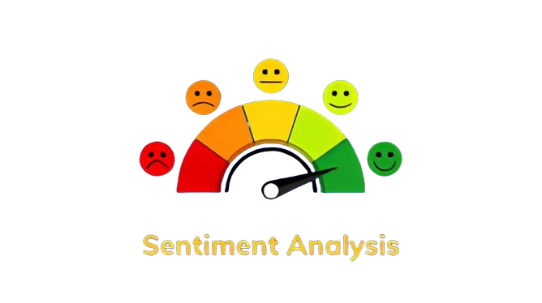
Introduction
Sentiment Analysis is the process of identifying and categorizing opinions, emotions, and attitudes expressed in text data.
Emphasizing the role of sentiment analysis in enhancing the overall audience experience by tailoring content and services to meet viewer expectations and preferences.

Slide 4

About the Dataset
Description
A movie review dataset tailored for sentiment analysis tasks.
Notable characteristic: Lengthy movie reviews, with many exceeding 200 words.
Movie Review Dataset
Importance
Analyzing longer reviews captures nuanced sentiments.
Relevance in real-world NLP applications.

Slide 5
Context
Objective: Sentiment analysis to gauge audience reactions towards movies.
Importance of sentiment analysis in guiding marketing strategies and decision-making in the film industry.
Dataset Context
Columns
"text": Movie review.
"label": Sentiment label.

Slide 6






Definition
Measure of correctly classified positive and negative sentiments
Evaluation Metric
Importance
Binary Accuracy
Accurate sentiment classification informs decision-making processes in the film industry.

Slide 7
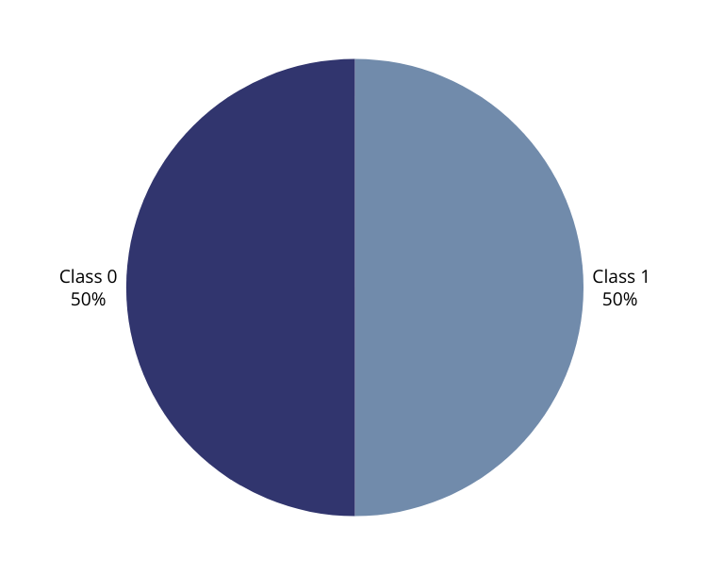
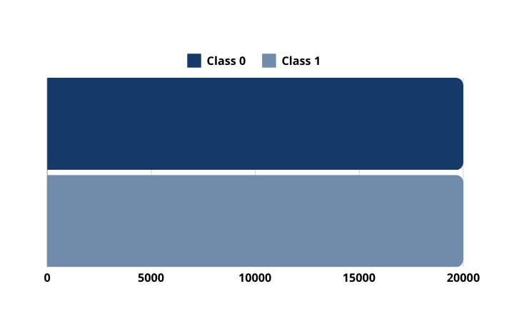
Data Visualization
Class Distribution
Class separation must be balanced in order to get the greatest accuracy possible.

Slide 8
Text Preprocessing
1
2
3
4
4
Tokenization
Lowercasing
Removing punctuation and stopwords
Lemmatization
Vectorizing
max features
[10,000]

Slide 9
Models
Logistic Regression
Naive Bayes
SVM
Random Forest
etc.
Traditional Machine Learning Approach
Suitability
These models are well-suited for handling lengthy text data and effectively representing features.

Slide 10
Models
Focus on BERT
Deep Learning Approach
Advantages
Capturing contextual information from lengthy text.
Parameters
Fine-tuning: Learning rate[0,02m], number of epochs[3].
Model architecture: BERT-base, max length [256]
batch size[32], Adam Optimizer

Slide 11

Training and Evaluation
Procedures
Data splitting into training, validation, and test sets
Monitoring accuracy and loss metrics during training.
Evaluation on the test set using binary accuracy.

Slide 12
Traditional Machine Learning Models
Confusing Matrix and Accuracy

Slide 13
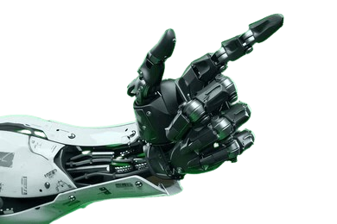
 | 0 | 1
0 | 2164 | 322
1 | 237 | 2277
Accuracy : 88.82%
Precision : 87.61
Recall : 90.57
Logistic Regression Model

Slide 14
 | 0 | 1
0 | 2129 | 357
1 | 357 | 2157
Accuracy : 85.72%
Precision : 85.79
Recall : 85.79
Naive Bayes Model

Slide 15
 | 0 | 1
0 | 2177 | 309
1 | 223 | 2291
Accuracy : 89.36%
Precision : 88.11
Recall : 91.12
Support Vector Machine Model

Slide 16
 | 0 | 1
0 | 2111 | 375
1 | 372 | 2142
Accuracy : 85.06%
Precision : 85.1
Recall : 85.2
Random Forest Model

Slide 17
Deep Learning
Models
Confusing Matrix and Accuracy

Slide 18
 | 0 | 1
0 | 2218 | 268
1 | 186 | 2328
Train Accuracy : 96.88
Test Accuracy : 0.90
Precision : 89.67
Recall : 92.60
BERT Model

Slide 19
Leaderboard
Submission Accuracy

Slide 20

Findings
Comparative effectiveness of traditional ML versus deep learning approaches.
Importance of effectively handling lengthy text in sentiment analysis tasks.
Conclusion
Implications
Marketing strategies, audience engagement, and future research directions.

Slide 21



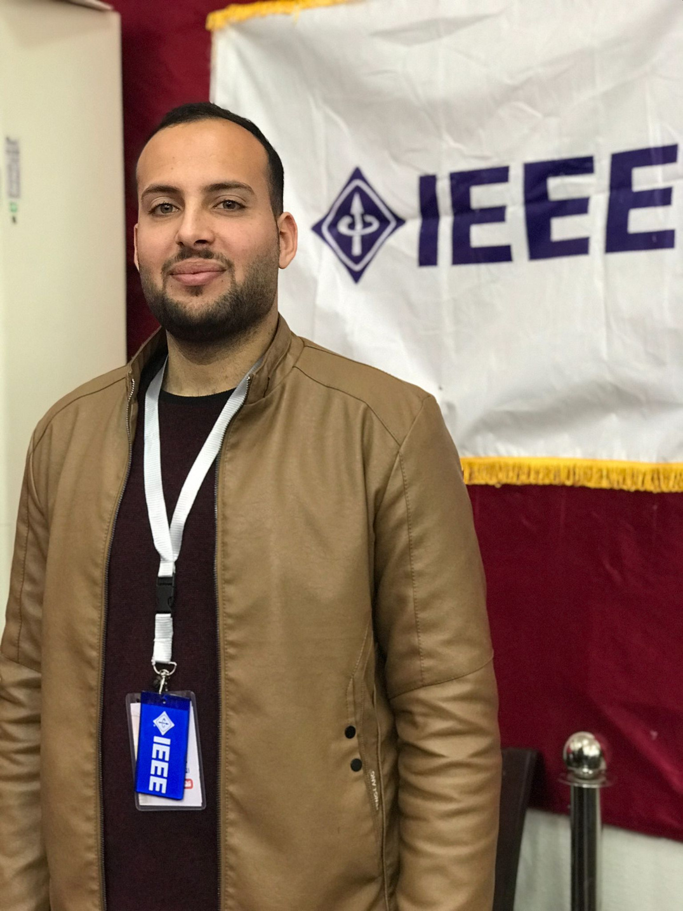
Team Members
Adam Ayyad
Electric Engineer
ayyadadam77@gmail.com
Ayah Abu Thib
Computer Systems Engineer
AyahAbuThib@gmail.com
Mahmoud Ghaboun
Electric Engineer
Mahmoud214d@gmail.com

Slide 22


Thank
You
I want to express my sincere appreciation to you, the discussion participants, and the entire(SHAI) team for an enriching training experience. Your guidance, insights, and support have been invaluable, and I am grateful for the opportunity to learn and grow alongside such a talented community. Thank you for your dedication to advancing AI education and for empowering learners like myself to pursue their passions.
https://www.facebook.com/ArabsAICommunity
10

